Slide 1
Unit - III
K-Nearest Neighbors and Naive Bayes

Slide 2
Different Learning Methods
Eager Learning
Explicit description of target function on the whole training set
Instance-based Learning
Learning=storing all training instances
Classification=assigning target function to a new instance
Referred to as “Lazy” learning

Slide 3
Different Learning Methods
Eager Learning
Any random movement
=>It’s a mouse
I saw a mouse!

Slide 4
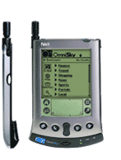
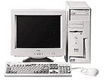

Instance-based Learning
Its very similar to a
Desktop!!

Slide 5
Instance-based Learning
K-Nearest Neighbor Algorithm
Weighted Regression
Case-based reasoning

Slide 6
K-Nearest Neighbor
Features
All instances correspond to points in an n-dimensional Euclidean space
Classification is delayed till a new instance arrives
Classification done by comparing feature vectors of the different points
Target function may be discrete or real-valued

Slide 7
1-Nearest Neighbor

Slide 8
3-Nearest Neighbor

Slide 9
K-Nearest Neighbor
An arbitrary instance is represented by (a₁(x), a₂(x), a₃(x),.., a_{n}(x))
a_{i}(x) denotes features
Euclidean distance between two instances
d(x_{i}, x_{j})=sqrt (sum for r=1 to n (a_{r}(x_{i}) - a_{r}(x_{j}))²)
Continuous valued target function
mean value of the k nearest training examples

Slide 10
K-nearest neighbors
K-nearest neighbors is a non-parametric machine learning model in which the model memorizes the training observation for classifying the unseen test data. It can also be called instance-based learning.
This model is often termed as lazy learning, as it does not learn anything during the training phase like regression, random forest, and so on.
Instead it starts working only during the testing/evaluation phase to compare the given test observations with nearest training observations, which will take significant time in comparing each test data point.
Hence, this technique is not efficient on big data; also, performance does deteriorate when the number of variables is high due to the curse of dimensionality.

Slide 11
KNN voter example
KNN is explained better with the following short example. Objective is to predict the party for which voter will vote based on their neighborhood, precisely geolocation (latitude and longitude).
Here we assume that we can identify the potential voter to which political party they would be voting based on majority voters did voted for that particular party in that vicinity, so that they have high probability to vote for the majority party.

Slide 12
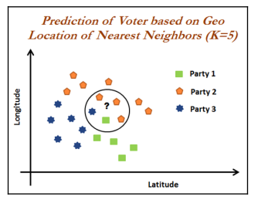

Slide 13
In the preceding diagram, we can see that the voter of the study will vote for Party 2.
As within the vicinity, one neighbor has voted for Party 1 and the other voter voted for Party 3. But three voters voted for Party 2. In fact, by this way KNN solves any given classification problem.
Regression problems are solved by taking mean of its neighbors within the given circle or vicinity or k-value.

Slide 14
Distance-Weighted Nearest Neighbor Algorithm
Assign weights to the neighbors based on their ‘distance’ from the query point
Weight ‘may’ be inverse square of the distances
All training points may influence a particular instance
Shepard’s method

Slide 15
Remarks
+Highly effective inductive inference method for noisy training data and complex target functions
+Target function for a whole space may be described as a combination of less complex local approximations
+Learning is very simple
- Classification is time consuming

Slide 16
Remarks
- Curse of Dimensionality

Slide 17
Remarks
Efficient memory indexing
To retrieve the stored training examples (kd-tree)

Slide 18
Curse of dimensionality
KNN completely depends on distance. Hence, it is worth studying about the curse of dimensionality to understand when KNN deteriorates its predictive power with the increase in number of variables required for prediction.
This is an obvious fact that highdimensional spaces are vast.
Points in high-dimensional spaces tend to be dispersing from each other more compared with the points in low-dimensional space.
Though there are many ways to check the curve of dimensionality, here we are using uniform random values between zero and one generated for 1D, 2D, and 3D space to validate this hypothesis.

Slide 19
In the following lines of codes, mean distance between 1,000 observations have been calculated with the change in dimensions.
It is apparent that with the increase in dimensions, distance between points increases logarithmically, which gives us the hint that we need to have exponential increase in data points with increase in dimensions in order to make machine learning algorithms work correctly:

Slide 20
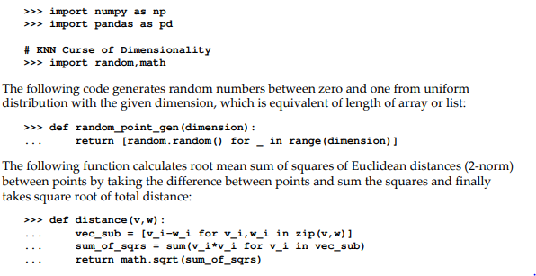

Slide 21
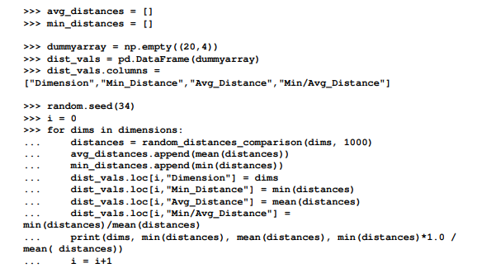

Slide 22
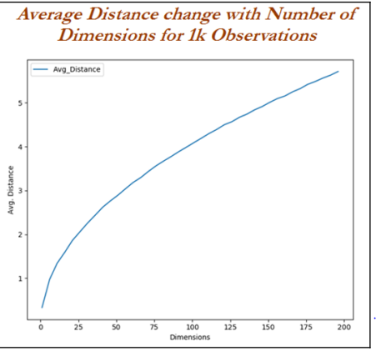

Slide 23
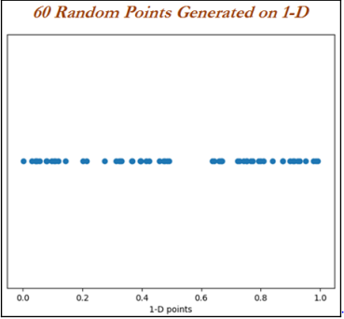
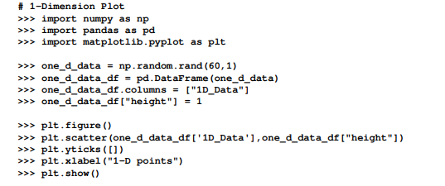
Curse of dimensionality with 1D example

Slide 24
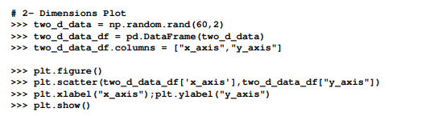
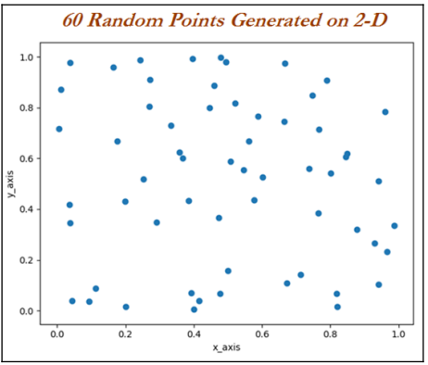
Curse of dimensionality with 2D example

Slide 25
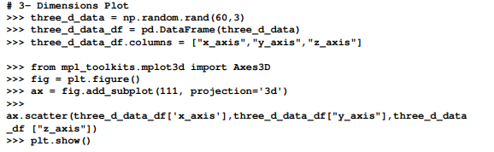
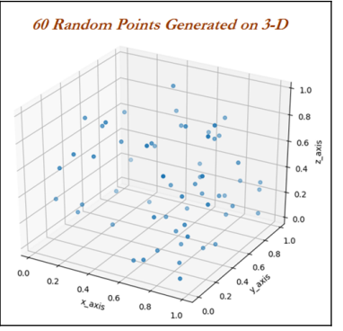
Curse of dimensionality with 3D example

Slide 26

KNN classifier with breast cancer Wisconsin data example
Breast cancer data has been utilized from the UCI machine learning repository http://archive.ics.uci.edu/ml/datasets/Breast+Cancer+Wisconsin+%28Diagnostic%29 for illustration purposes. Here the task is to find whether the cancer is malignant or benign based on various collected features such as clump thickness and so on using the KNN classifier:

Slide 27
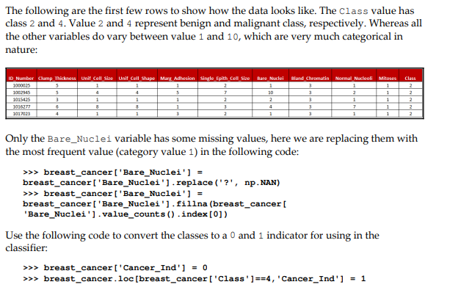

Slide 28
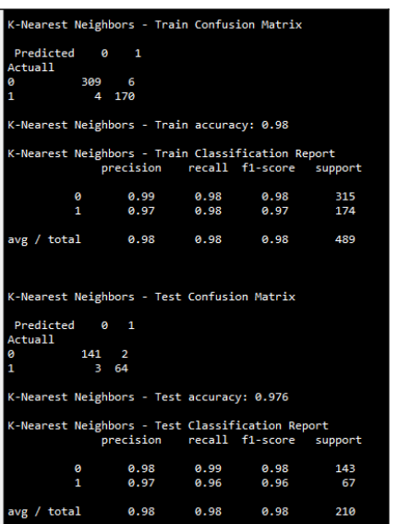

Slide 29
Naïve Bayes

Slide 30
Things We’d Like to Do
Spam Classification
Given an email, predict whether it is spam or not
Medical Diagnosis
Given a list of symptoms, predict whether a patient has disease X or not
Weather
Based on temperature, humidity, etc… predict if it will rain tomorrow

Slide 31
Bayesian Classification
Problem statement:
Given features X₁,X₂,…,X_{n}
Predict a label Y

Slide 32
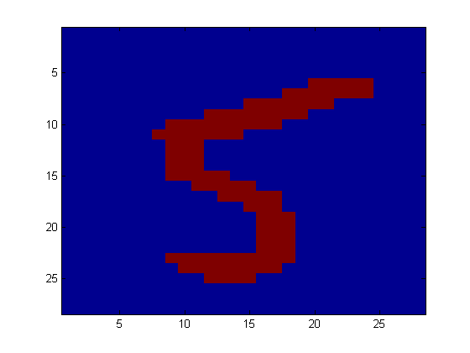
Another Application
Digit Recognition
X₁,…,X_{n} ∈ {0,1} (Black vs. White pixels)
Y ∈ {5,6} (predict whether a digit is a 5 or a 6)
Classifier
5

Slide 33

The Bayes Classifier
A good strategy is to predict:
(for example: what is the probability that the image represents a 5 given its pixels?)
So … How do we compute that?

Slide 34
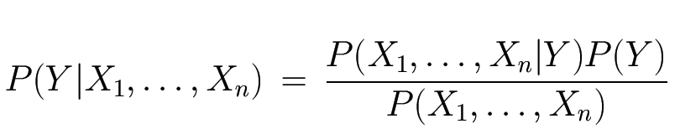
The Bayes Classifier
Use Bayes Rule!
Why did this help? Well, we think that we might be able to specify how features are “generated” by the class label
Likelihood
Prior
Normalization Constant

Slide 35
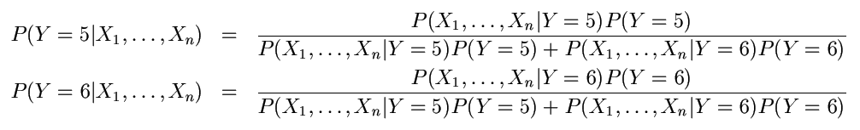
The Bayes Classifier
Let’s expand this for our digit recognition task:
To classify, we’ll simply compute these two probabilities and predict based on which one is greater

Slide 36
Probability fundamentals
Before diving into Naive Bayes, it would be good to reiterate the fundamentals. Probability of an event can be estimated from observed data by dividing the number of trails in which an event occurred with total number of trails. For instance, if a bag contains red and blue balls and randomly picked 10 balls one by one with replacement and out of 10, 3 red balls appeared in trails we can say that probability of red is 0.3, pred = 3/10 = 0.3.
Total probability of all possible outcomes must be 100 percent. If a trail has two outcomes such as email classification either it is spam or ham and both cannot occur simultaneously, these events are considered as mutually exclusive with each other.
In addition, if those outcomes cover all possible events, it would be called as exhaustive events. For example, in email classification if P (spam) = 0.1, we will be able to calculate P (ham) = 1- 0.1 = 0.9, these two events are mutually exclusive. In the following Venn diagram, all the email possible classes are represented (the entire universe) with type of outcomes:

Slide 37
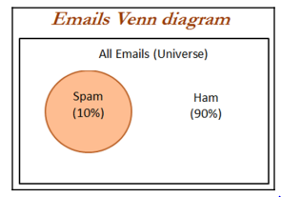

Slide 38
Joint probability
Though mutually exclusive cases are simple to work upon, most of the actual problems do fall under the category of non-mutually exclusive events. By using the joint appearance, we can predict the event outcome. For example, if emails messages present the word like lottery, which is very highly likely of being spam rather than ham.
The following Venn diagram indicates the joint probability of spam with lottery. However, if you notice in detail, lottery circle is not contained completely within the spam circle. This implies that not all spam messages contain the word lottery and not every email with the word lottery is spam

Slide 39
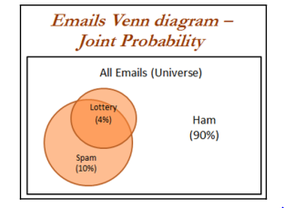

Slide 40
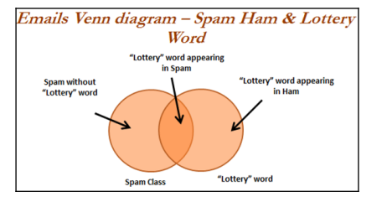

Slide 41
We have seen that 10 percent of all the emails are spam and 4 percent of emails have the word lottery and our task is to quantify the degree of overlap between these two proportions. In other words, we need to identify the joint probability of both p(spam) and p(lottery) occurring, which can be written as p(spam ∩ lottery).
In case if both the events are totally unrelated, they are called independent events and their respective value is p(spam ∩ lottery) = p(spam) * p(lottery) = 0.1 * 0.04 = 0.004, which is 0.4 percent of all messages are spam containing the word Lottery. In general, for independent events P(A∩ B) = P(A) * P(B).

Slide 42

Understanding Bayes theorem with conditional probability
Conditional probability provides a way of calculating relationships between dependent events using Bayes theorem.
For example, A and B are two events and we would like to calculate P(A\B) can be read as the probability of event occurring A given the fact that event B already occurred, in fact this is known as conditional probability, the equation can be written as follows:

Slide 43
To understand better, we will now talk about the email classification example. Our objective is to predict whether email is spam given the word lottery and some other clues. In this case we already knew the overall probability of spam, which is 10 percent also known as prior probability.
Now suppose you have obtained an additional piece of information that probability of word lottery in all messages, which is 4 percent, also known as marginal likelihood. Now, we know the probability that lottery was used in previous spam messages and is called the likelihood.

Slide 44
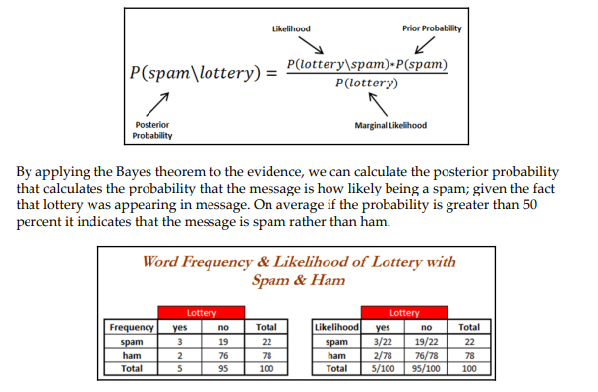

Slide 45
In the previous table, the sample frequency table that records the number of times Lottery appeared in spam and ham messages and its respective likelihood has been shown. Likelihood table reveals that P(Lottery\Spam)= 3/22 = 0.13, indicating that probability is 13 percent that a spam message contains the term Lottery.
Subsequently we can calculate the P(Spam ∩ Lottery) = P(Lottery\Spam) * P(Spam) = (3/22) * (22/100) = 0.03. In order to calculate the posterior probability, we divide P(Spam ∩ Lottery) with P(Lottery), which means (3/22)*(22/100) / (4/100) = 0.75. Therefore, the probability is 75 percent that a message is spam, given that message contains the word Lottery.

Slide 46
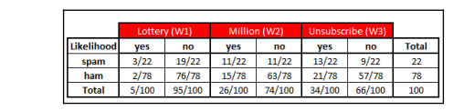
Naive Bayes classification
In the past example, we have seen with single word called lottery, however, in this case we will be discussing with a few more additional words such as Million and Unsubscribe to show how actual classifiers do work. Let us construct the likelihood table for the appearance of the three words (W1, W2, and W3), as shown in the following table for 100 emails:

Slide 47
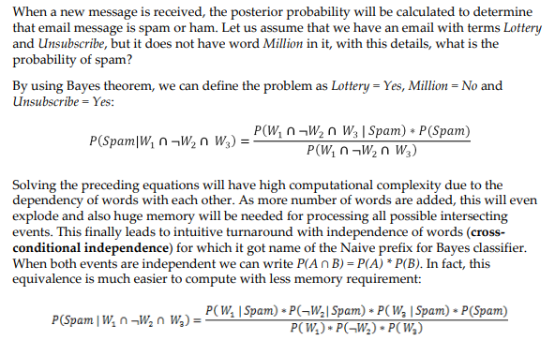

Slide 48
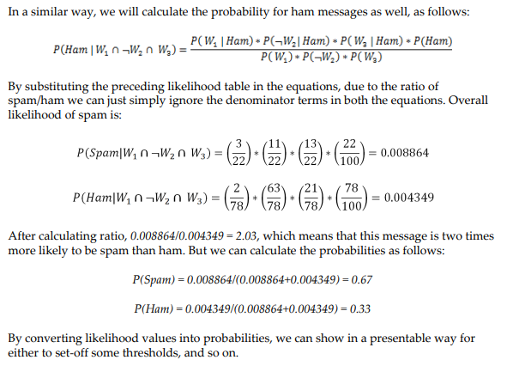

Slide 49

Laplace estimator
In the previous calculation, all the values are nonzeros, which makes calculations well. Whereas in practice some words never appear in past for specific category and suddenly appear at later stages, which makes entire calculations as zeros. For example, in the previous equation W3 did have a 0 value instead of 13, and it will convert entire equations to 0 altogether:

Slide 50
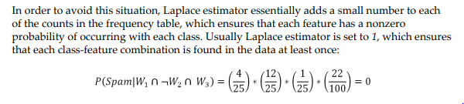

Slide 51
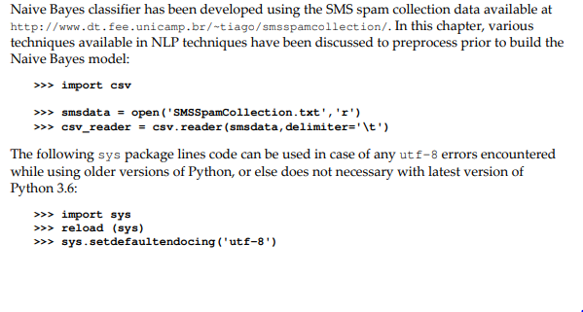
Naive Bayes SMS spam classification example

Slide 52
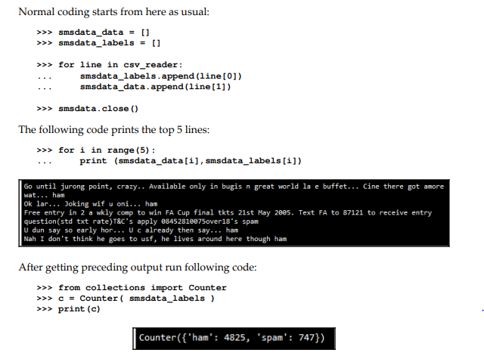

Slide 53
Using NLP techniques, we have preprocessed the data for obtaining finalized word vectors to map with final outcomes spam or ham. Major preprocessing stages involved are:
Removal of punctuations: Punctuations needs to be removed before applying any further processing. Punctuations from the string library are !"#$%&\'()*+,- ./:;<=>?@[\\]^_`{|}~, which are removed from all the messages.
Word tokenization: Words are chunked from sentences based on white space for further processing.

Slide 54
Converting words into lower case: Converting to all lower case provides removal of duplicates, such as Run and run, where the first one comes at start of the sentence and the later one comes in the middle of the sentence, and so on, which all needs to be unified to remove duplicates as we are working on bag of words technique.
Stop word removal: Stop words are the words that repeat so many times in literature and yet are not much differentiator in explanatory power of sentences. For example: I, me, you, this, that, and so on, which needs to be removed before further processing.
of length at least three: Here we have removed words with length less than three.

Slide 55
Keeping words of length at least three: Here we have removed words with length less than three. Stemming of words: Stemming process stems the words to its respective root words. Example of stemming is bringing down running to run or runs to run. By doing stemming we reduce duplicates and improve the accuracy of the model.
Part-of-speech (POS) tagging: This applies the speech tags to words, such as noun, verb, adjective, and so on. For example, POS tagging for running is verb, whereas for run is noun. In some situation running is noun and lemmatization will not bring down the word to root word run, instead it just keeps the running as it is. Hence, POS tagging is a very crucial step necessary for performing prior to applying the lemmatization operation to bring down the word to its root word.
Lemmatization of words: Lemmatization is another different process to reduce the dimensionality. In lemmatization process, it brings down the word to root word rather than just truncating the words. For example, bring ate to its root word as eat when we pass the ate word into lemmatizer with the POS tag as verb

